Slide 1

CSCI599
Dami
Team Members:
Lijie Zhao
Haichao Ma
Chien-Hao Huang
Ta-Yang Wang
Ying Cheng

Slide 2
Project detail
We created a racing game in a snowy terrain by Unity, where players have to control an flying object that goes through the race track without crashing into obstacles. Specifically, the flying object should fly through each checkpoint within few seconds and complete two laps of the race.
During the travel, players also need to overcome several environmental physical challenges, including rocks and water. Once the flying object coinciding with obstacles, it will crash immediately, and players have to restart from the last checkpoint.
With the using of the ML-Agent, which provides an implementation of PPO algorithm, we are able to train the flying objects as agents to travel around the race track without running into obstacles within the time limitation.

Slide 3
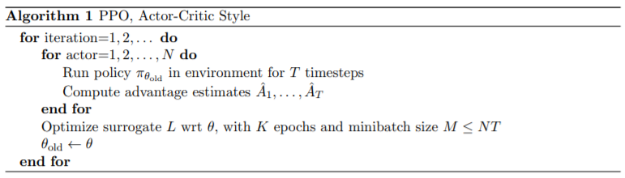

Proximal Policy Optimization
Works for continuous action space
Learn the advantage of an action
Ease of implementation
Notes:
A proximal policy optimization (PPO) algorithm that uses fixed-length trajectory segments is shown below. Each iteration, each of N (parallel) actors collect T timesteps of data. Then we construct the surrogate loss on these NT timesteps of data, and optimize it with minibatch SGD (or usually for better performance), for K epochs.

Slide 4
Expected results
Checkpoint will be changed to gifts.
The aim for this game is to find the best way which can obtain more gifts.
Sledge hits boundaries and crash for punishment
Gifts has its own boundaries for movements which is invisible small rectangle box
Raycast used for object detection served as the information input.
Smart Agent

Slide 5
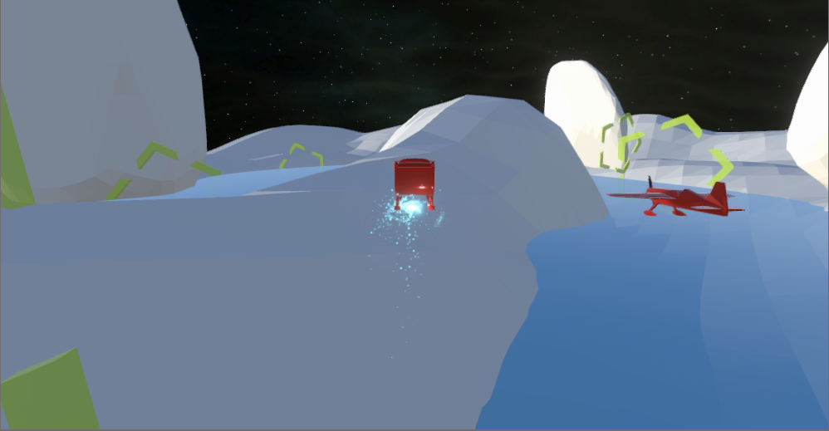
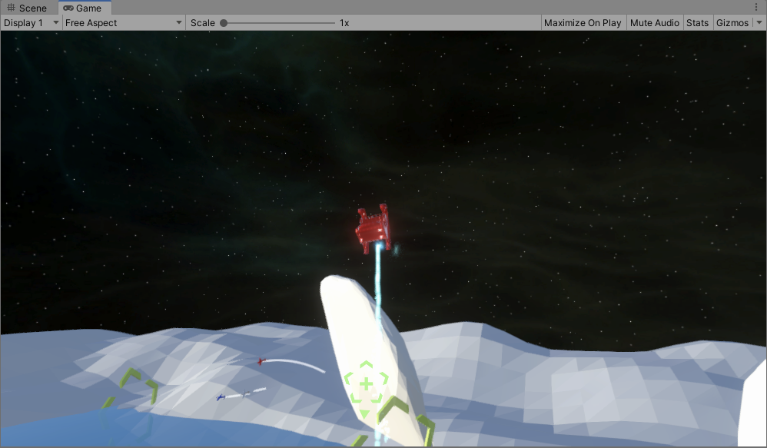
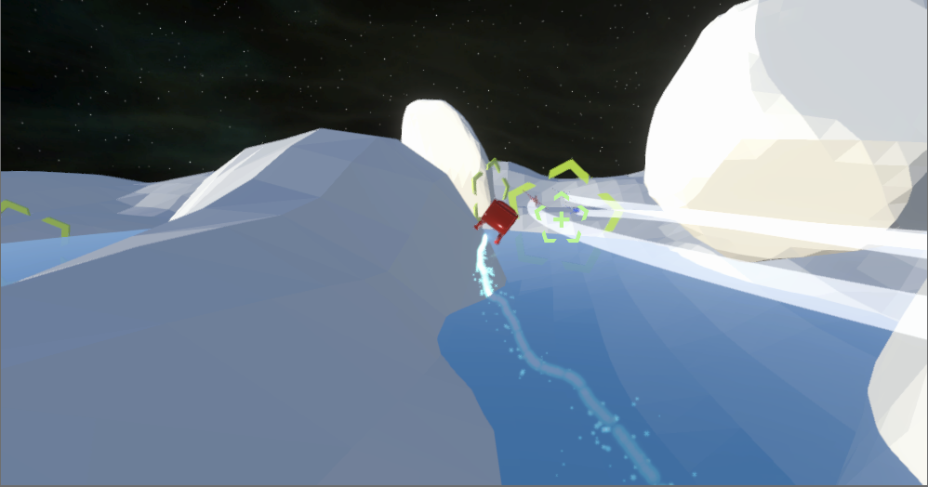
Current progress

Slide 6
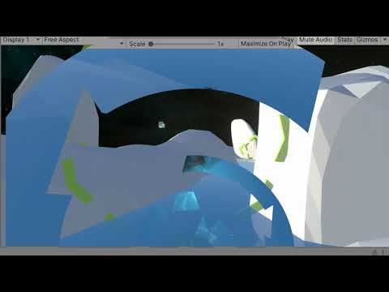

Slide 7
CSCI599
Thank You

